Slide 1

Chuth Ber Sola Maji Kiosk
A study of water recontamination in the household
Digital Story – Pat Dowling
Notes:
Welcome to my digital story. Let me introduce you to the Chuth Ber Sola Maji Kiosk, located about 50 minutes from Kisumu in a peri-urban area. Maji is the Swahili word for water. And Sola meaning Solar. Across Kenya many people opt to buy clean water from a kiosk to bring home for drinking. My study is about the recontamination of that water.

Slide 2
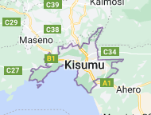


My road to Kisumu!
Sola Maji Project – clean and sustainable drinking water
Research entry point - SWAP Kenya in Kisumu, Western Kenya
University of Illinois Chicago, School of Public Health ongoing studies on water recontamination with SWAP Kenya
Notes:
Kisumu is located on the banks of the great Lake Victoria, which borders Uganda, Kenya and Tanzania. It is there, that SWAP Kenya started as an NGO17 years ago with one of their functions revolving around public health programs. In a partnership with the University of Illinois Chicago, the school of Public Health piloted a water kiosk close to Kisumu, that used ozone water treatment via an ozone generator powered by solar energy to clean river water pumped to a nearby water kiosk. It works whereby this ozone is injected into water, and immediately starts oxidizing and eliminating contaminants, such as bacteria, viruses, and metals.

Slide 3
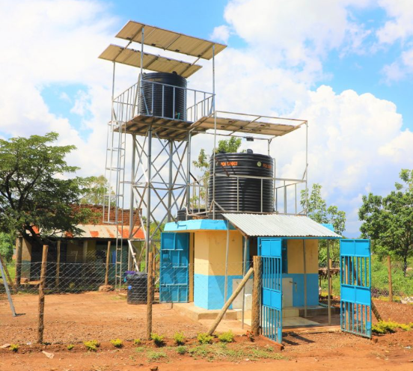
My Research Question ......
2023 UIC & SWAP Ongoing Research……
Phase 1a Household surveys around Chuthber (January)
Phase 1b Water testing of household samples (February )
In what way do the practices around managing water in the home (use, hygiene and storage patterns) in the Chuth Ber/Mugruk peri-urban area impact households in the re-contamination of healthy purified Sola Maji kiosk water?
Notes:
In early 2023 the UIC and SWAP Kenya were conducting research at an up and running established Sola Maji water kiosk in the ChuthBer area. The Mugruk river is the source of water that is pumped to their Sola Maji kiosk. Their research focused on the community of this area. They conducted surveys investigating water sources used in households and taking samples of the stored drinking water in these households to test in the SWAP Kenya labs for coliforms and E.Coli bacteria along with turbidity levels. These samples included water bought from the Sola Maji kiosk, along with other sources like river water, boreholes, piped water and so forth. I put forward an idea to focus on specific research where water was being re-contaminated in the home and how that was happening. This was given a green light and I started my research end of January, early February this year. My research question thusfar is…..

Slide 4
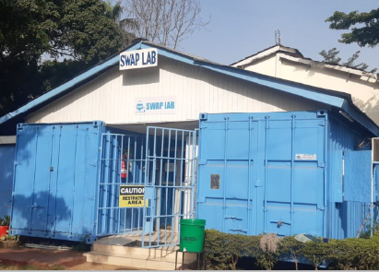

Shaping the research
Initial Plan – Ethnographic research with local family/famlies followed by 2 Focus Group discussions
Phase 2a (March) – Ethnography at Sola Maji Chuth Ber Kiosk
Phase 2b (March) – Boda Boda Rider Interviews x 3
Phase 2c (March/April) – Focus Group Discussions x 2
Notes:
Initially ethnographic research spending time with a local family observing their water management practices was a possible approach. After some time visiting famlies, taking water samples and getting to know the community, it was felt that there was a story to be told by observing activities at the kiosk firstly. From that experience, I learned that possible re-contamination of kiosk water was possibly starting at points outside the homes, for example with Boda Boda water delivery riders. Thus interviews with some were planned. Focus group sessions were initially planned and did happen nearer the final stages as I became more familiar with the community locals. I gained access to these groups of ladies from time spent locally at the kiosk, and whereby I confirmed that women were the ones who managed water in the homes thus were best placed to participate in the focus groups.

Slide 5
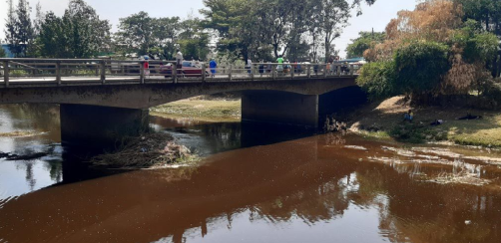
1. Approach – Home Ethnography
Assisting in Phase 1, taking water samples in several homes was revealing as partial ethnographic observation
Home environment set up/comfort level/suitable candidate family – feasibility?
Other aspects for the research became important and allowed for this ‘family-stay’ approach to be side-lined
Notes:
From assisting in drinking water sample collection in Phase 1 in conjunction with my SWAP Kenya colleagues, it was the perfect opportunity to become familiar with my surroundings, the environment, the ways of living and gain knowledge from my colleagues whom had worked in this community for close to 4 years. I learned more about where water was stored, how it was managed, transported and used. In terms of the feasibility of me observing a family for up to a week, I considered this with SWAP Kenya. Based on the ongoing lack of rains, the living situation for some and my observations, it was decided that other opportunities were presenting themselves where the research could yield equally rich results.

Slide 6
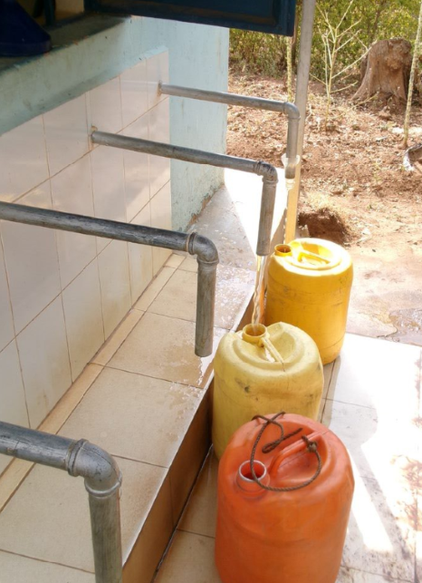
2. Approach – Kiosk Observations
Kiosk Ethnography yielded other findings
Opportunity to get familiar with local community
Cleanliness (jerrycans, funnel use, hand hygiene)
Kiosk signage /raise awareness
Dependency on one kiosk manager (success/failure)
Notes:
From spending time at the Chuthber kiosk, I found from an ethnographic research point of view it yielded other insights. Very importantly it was the chance to get familiar with local community and how the kiosk was a hub close to the river. It was understood then that the operation of the kiosk was also a potential point of recontamination of healthy water. Thus the focus on re-contamination broadened to not just inside the home, but to activities happening before the water arrived to the home. Some improvement points were observed or opportunities to raise awareness. And notably the success/failure of a water kiosk manager was deemed important in the observations.

Slide 7
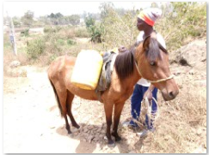
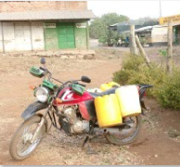
3. Approach – Boda Boda Delivery
1st point of re-contamination – active observations
Lack of knowledge on Sola Maji water cleaning process
Hesitant to share feedback to kiosk manager
Conflicting stories on their jerrycan cleaning
Missed opportunity to manage this service
Notes:
Boda Boda riders are an important part of the water delivery. From kiosk ethnography, it became evident that they were also a 1st point of possible water recontamination with for example dirty jerrycans being used for transportation of water to the homes. Questions arose over their care around the quality of the water, and their interaction with the community they served. Learning more from those fulfilling this role in this area became very important and a valuable source of information.

Slide 8
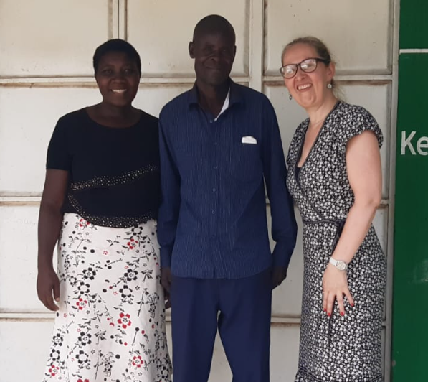
4. Approach – Focus Groups
Women – manage the water at home (more than expected)
FG questions altered due to earlier observations in the research
Cleaning jerrycan properly (questionable/river water)
Children, animals – point of recontamination
Feedback/conflict on boda boda service became important
Notes:
The focus groups were always going to be an integral part of the research. The focus group guide changed slightly after the kiosk research and the interviews with the Boda Boda riders. Women manage water at home in Kenya typically as is the cultural norm and thus would be invited to attend the Focus groups. Topics like cleaning jerrycans properly and opinions on managing the water at home around children, animals, etc was important to learn more about. Interaction with the Boda Boda service was delved into. Hygiene, health improvements and the cleaning of jerrycans remained a focus in the sessions also and this became an important point from other information gained in earlier research. Due to the local language being Luo, and Swahili being widely spoken, it was integral to have the FG attended by a colleague from SWAP Kenya who could translate.

Slide 9
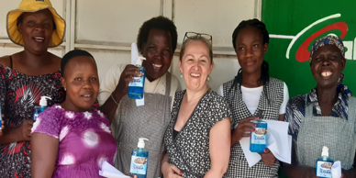
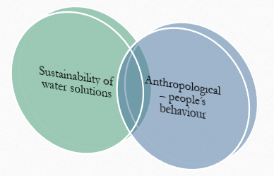
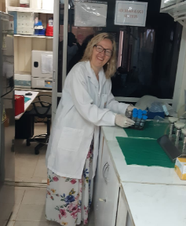
Methods
Ethnography
Interviews
Focus Groups
Notes:
This research incorporates interdisciplinary aspects between an anthropological view of people, and with the aspect of a sustainable water solution in communities. It can occur that great solutions are not sustainable if it does not comply with the audience needs and behaviours. Using ethnography, interviews and focus groups across three overlapping data sets gave rise to findings and observations for the Sola Maji Chuthber kiosk and aims to add value for the preparation and ongoing running of future planned kiosks by the University of Illinois and SWAP Kenya.

