Slide 1
Chuth Ber Sola Maji Kiosk A study of water recontamination in the household
Pat Dowling, Masters in African Studies
Leiden University, The Netherlands
Notes:
Chuth Ber is located about 50 minutes from Kisumu in a peri-urban area.

Slide 2
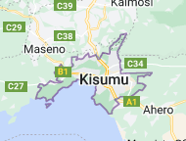
My road to Kisumu!
Masters African Studies – Leiden University
10 week internship in Africa
Interest in innovation, community research
Engagement with SWAP Kenya through recommendation (Pesh)
University of Illinois Chicago School of Public Health study
Approvals from JOOUST Ethics Committee to engage
Notes:
Pesh my supervisor at SWAP Kenya. University supervisor in Leiden..
Ozone water treatment begins with the creation of ozone in an ozone generator. Then, ozone is injected into water, and immediately starts oxidizing and eliminating contaminants, such as bacteria, viruses, and metals. Ozone oxidizes organic material in the membranes of bacteria, viruses, and parasites.

Slide 3
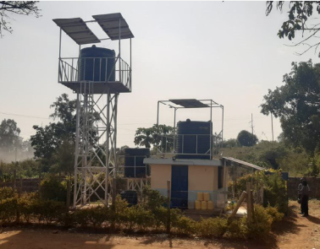
Research Question
In what way do the practices around managing water in the home (use, hygiene and storage patterns) in the Chuth Ber/Mugruk peri-urban area impact households in the re-contamination of healthy purified Sola Maji kiosk water?
Notes:
My research question as it stands today

Slide 4
Why is this relevant?
Reducing diarrhoeal
health issues
Frugal, cost effective, closing a gap for water shortages
Sola Maji longevity & expansion plans
Notes:
Frugal innovation is the process of reducing the complexity and cost of a good and its production

Slide 5
Multidisciplinary
Sustainability of water solutions
Anthropological – people’s behaviour
Notes:
My research is multidisciplinary and sustainability of solutions, alongside the anthropological angle around people’s behaviour is of interest to me in this study

Slide 6
Phased approach
Phase 1a – Surveys in Mugruk (January 2023)
Phase 1b – Surveys & Water testing in Mugruk (February 2023)
Phase 2a (March) – Boda Boda Rider Interviews x 3
Phase 2b (March) – Ethnography at Sola Maji Chuth Ber Kiosk
Phase 2c (March/April) – Focus Group Discussions x 2
Source: Deloitte and Unicef
Notes:
Phase 2a to 2c was my focus. Also in mid April dissemination of the results of the water testing in the homes was a good opportunity to see the reaction from households while they received the results of the water tested in their home. Re-contamination was proven to happen in many households.

Slide 7
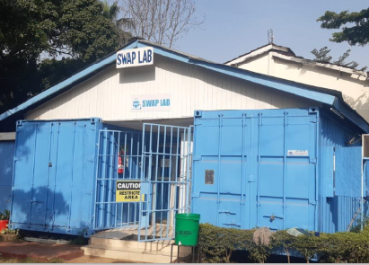
Implications….
Understanding the home practices
Observing points of recontamination
Focus group feedback = new insights?
Identify gaps to share
Can solutions be identified?
Notes:
In conducting any research we want to focus our research, understand findings, and ascertain if we can implement any action that will improve or add value from what we discovered. This research can result in a community impact and add some value to the Sola Maji kiosk projects in operation and those in planning for future phases.

Slide 8
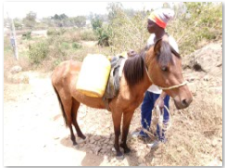
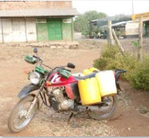
My Findings – Boda Boda Riders
1st point of re-contamination
Lack of knowledge on Sola Maji
Hesitant to share feedback to kiosk manager
Conflicting stories on their jerrycan cleaning
Missed opportunity to manage this service
Notes:
Bodaboda riders are an important part of the water delivery. Also a 1st point of recontamination with dirty jerrycans. They use jerry cans to transport river water also. Questions remain over their care and attention to clean jerrycans and their interaction with the community they service.

Slide 9
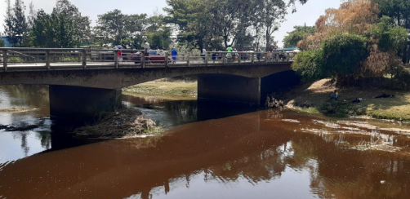
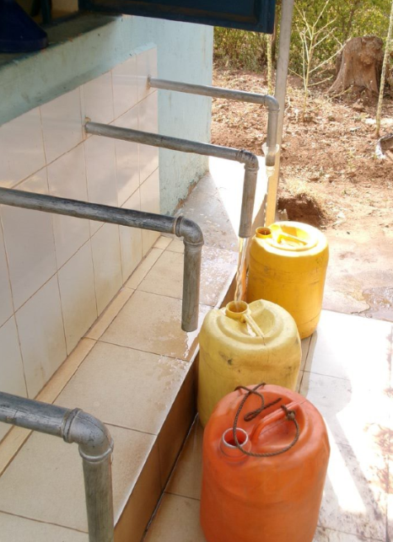
My Findings – Kiosk Observations
Opportunity to raise awareness on hygiene
Funnel use jerrycans, hand hygiene to revisit
Kiosk signage could add more value
Second tank needed to ensure continuous supply at kiosks
Risk of dependency on one kiosk manager (success/failure)
Pre-filling jerrycans – example of pro-active practices

Slide 10
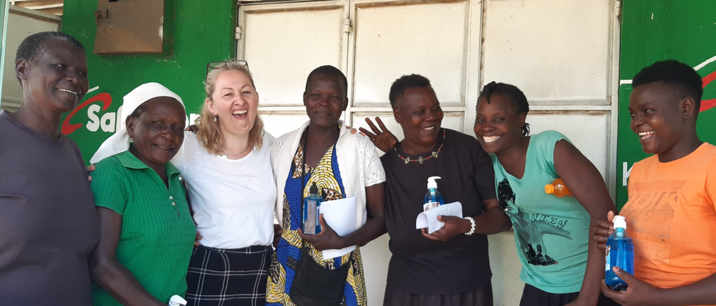
Notes:
Focus Group 1

Slide 11
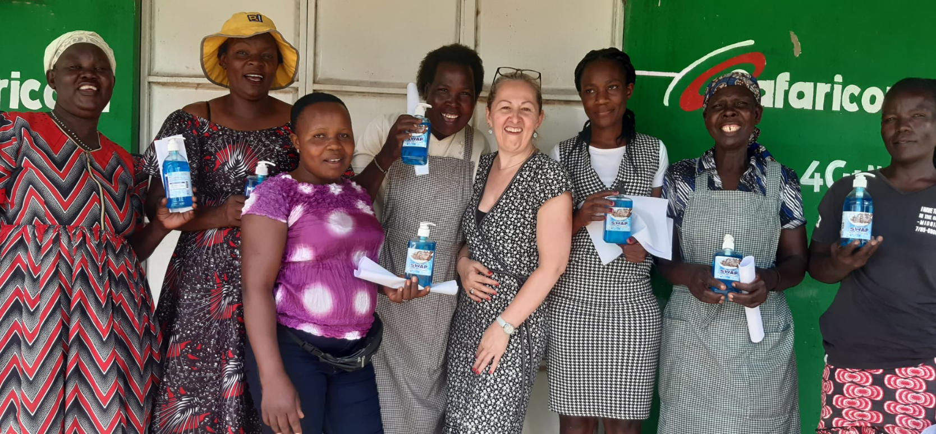
Notes:
Focus Group 2

Slide 12
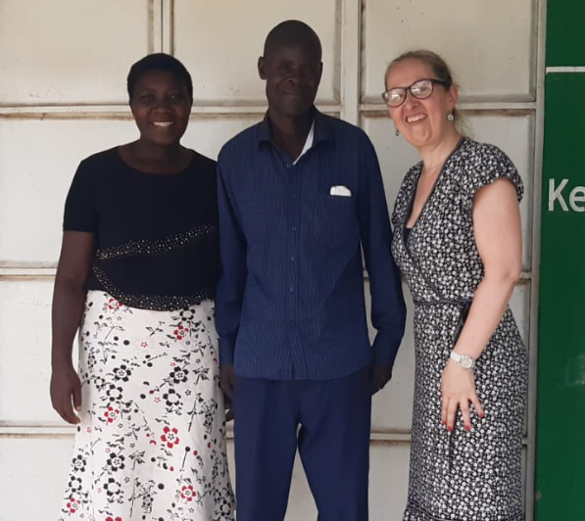
My Findings – Focus Groups
Cleaning jerrycan properly (questionable/river water)
Clear target women – manage the water at home
Children, animals – point of recontamination
Good price, happy with service & water quality
Clear understanding of health benefits
Negative feedback on bodaboda service/clean jerrycans
Training on points of home re-contamination necessary & suggested remedy

Slide 13
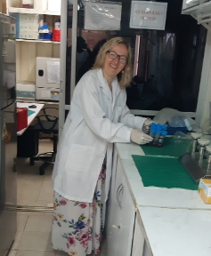
Recommendations….
Bodaboda riders – ‘partnership’ ‘engagement’ with kiosks
Water management awareness program
More ‘educational’ signage at kiosks
Handwash station at entry of kiosk (a must use policy)
Prepare pre-filled jerrycans ‘in stock’ where possible
Sale of new jerrycans at kiosk at competitive price
Track repeat customers, supply info leaflet (hygiene practices, contamination at home).
Notes:
Bodaboda riders are an initial point of risk for contamination of Sola Maji water. Suggest a program of partnership with using always clean jerrycan for delivery. Use other colour jerrycan for river water. Strictly no cross contamination. Spot checks done by kiosk management for any Bodaboda riders that wish to work with Sola Maji kiosks. Also training them about Sola Maji and kiosk practices.

Slide 14
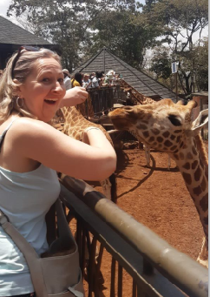
The Output….
Share data - SWAP Kenya and Dr. Sam
New findings/add value
Thesis - 30th June
Making friends with a giraffe…..
Massive gratitude to my SWAP Kenya family and the University of Illinois!
Erokamano !

