Slide 1
Through The Mirror Moments
Research Process

Slide 2
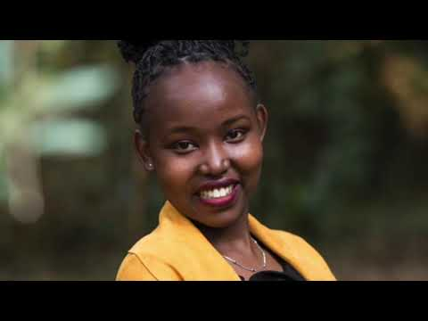
Internship Moments
My internship began with the organisation of a Webinar Series which explored ILO's definition of a 'decent job'.
This sparked the interest of my current topic which looks at a gendered perspective of decent employment in Kenya.
This brings me straight to my second moment which was the webinar in Kenya, where I made the decision to go for Kenya rather than including all the 10 countries from the webinar series in my research. The webinar in Kenya made me reflect on my methodology and pushed me to think of a new way I can use the data from the webinar series in my thesis.
Again, the webinar series pushed me to look beyond just finding female participants, but rather focus on looking for marginalised women, I.e wommen in the LGBTQ+ community as well as disabled women, in Kenya.

Slide 3
Other Moments
My third moment was when I presented my research proposal to Yinka and Andre. The feedback I received from them made me reconsider the age group I was hoping to research, which is something I have not really thought about before. This made my research more focused.
The process of changing my supervisor made me reflect on my topic and forced me rethink my initial methodology. I am no longer certain that I have enough time to conduct an ethnographic research as intended.

