Slide 1
The Decolonisation Discourse
Lionel Ndamba & Madi Ditmars van Niekerk
Language and Communication in Africa
2018

Slide 2
What is a Discourse?
Discourses refers to how we express what we think about people,
society and objects, and the relationships between these aspects.

Slide 3
What is a Discourse?
The Collins English Dictionary defines discourse as:
“Spoken or written communication between people, especially serious discussion of a particular subject … intended to teach or explain something.”
Discourse can never be neutral or value free – it always reflects ideologies, systems of values, beliefs and social practices.

Slide 4
BUT
Are our thoughts original
or just expressions of prevailing
Discourses

Slide 6
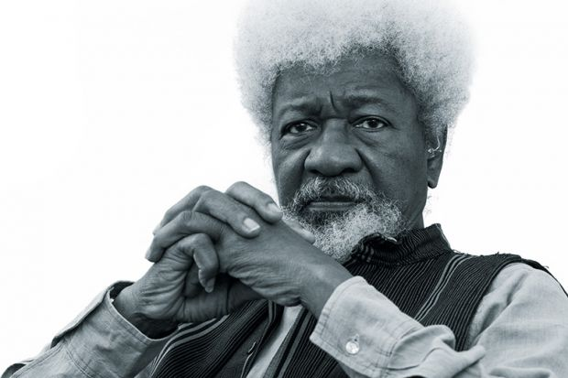
Still Colonised?
Wole Soyinka
(1934)
“The process of decolonisation was a very untidy one. The British, when they were finally leaving they knew exactly who they wanted to take over…, they wanted to continue indirectly in effect their control over much of their colonial possessions.”
Transcript from an interview with Wole Soyinka on 28 April 2005
https://www.timeshighereducation.com/features/wole-soyinka

Slide 8
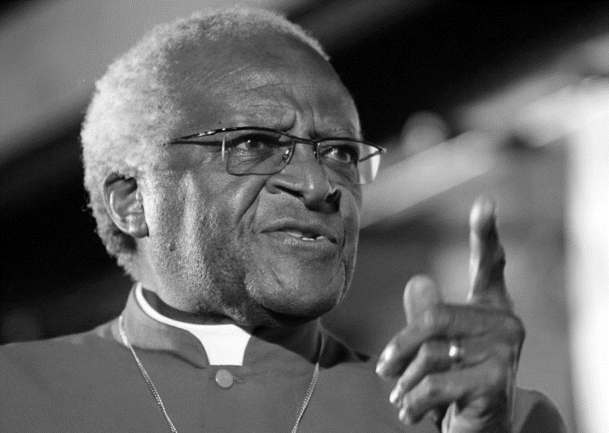
Corrupt Powers?
“Our government is worse than the apartheid government because at least you would have expected it with the apartheid government.”
Press conference 2011
Archbishop Desmond Tutu
(1931)
Reuters

Slide 10
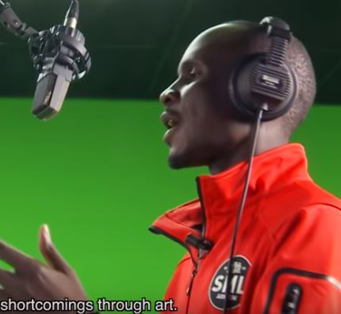
Power Relations?
“I would like to wear a helmet
One steering the dialogues between those in power and the population
That confronts our problems and their solutions
That responds to the cry of the youth
With real promises
And not with shooting of teargas
The killing, the detentions with no shame”
‘J’e voudrais porter un casque’
www.youtube.com/watch?v=g7KCLtlRU08
Croquemort

Slide 12
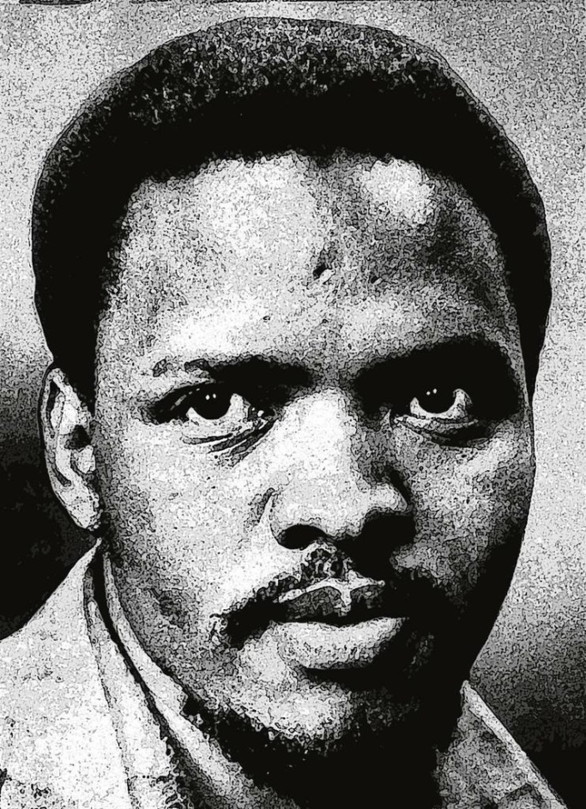
Self Esteem?
Steve Biko
(1946 - 1977)
“The first step therefore is to make the black man come to himself; to pump back life into his empty shell; to infuse him with pride and dignity.”
We Blacks, I Write What I Like
www.britannica.com/biography/Steve-Biko

Slide 14
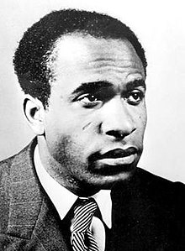
Self Acceptance?
“However painful it may be for me to accept this conclusion, I am obliged to state it: For the black man there is only one destiny. And it is white.”
Black Skin, White Mask
Franz Fanon
(1925 - 1961)
https://en.wikipedia.org/wiki/Frantz_Fanon

Slide 16
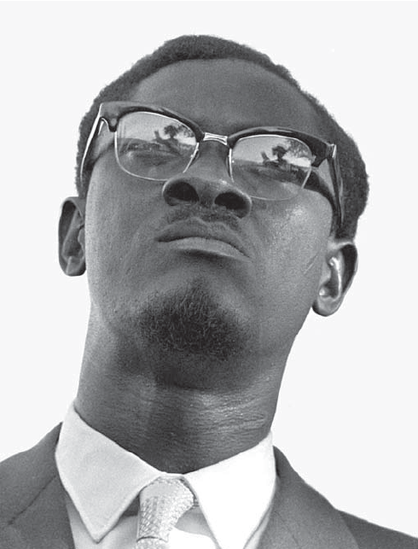
Own History?
“The day will come when history will speak. But it will not be the history which will be taught in Brussels, Paris, Washington or the United Nations.
It will be the history which will be taught in the countries which have won freedom from colonialism and its puppets.”
The Truth about a Monstrous Crime of the Colonialists
(Letter from Thysville Prison)
https://codepen.io/Gadliango/full/OXVvWb
Patrice Lumumba
(1925- 1961)

Slide 18
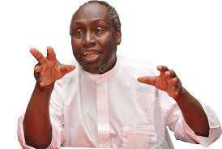
Decolonise the Mind?
“But its most important area of domination was the mental universe of the colonised, the control, through culture, of how people perceived themselves and their relationship to the world.”
Decolonising the Mind
Daily Monitor 22 August 2013
Ngũgĩ wa Thiong’o
(1938)

Slide 20
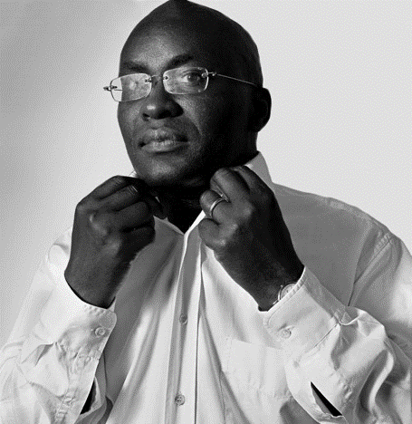
Decolonise Education?
Achille Mbembe
(1957)
“At the end of the decolonizing process, we will no longer have a university. We will have a pluriversity … a process of knowledge production that is open to epistemic diversity.
It does not necessarily abandon the notion of universal knowledge for humanity, but embraces it via a horizontal strategy of openness to dialogue among different epistemic traditions.”
Decolonizing the university: New directions
https://oldcapitolbooks.com/2016/03/20/theory-philosophy-reading-group-xvi-achille-mbembe/

Slide 22
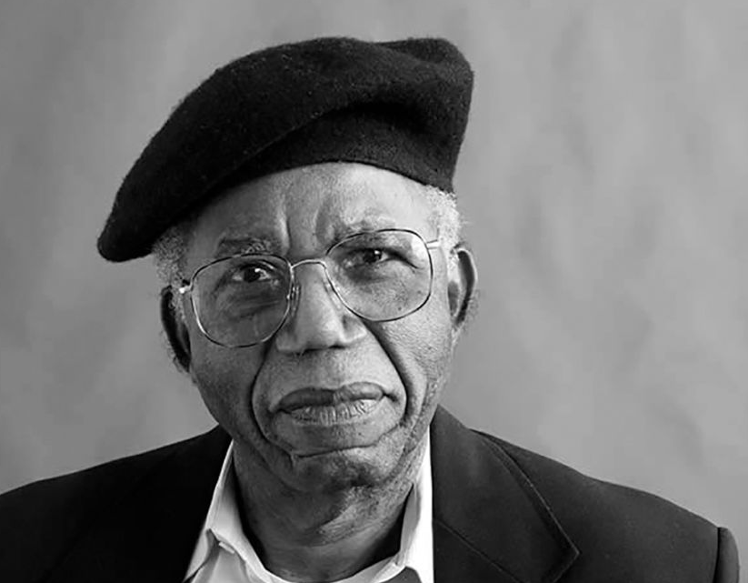
Language?
”I feel that the English language will be able to carry the weight of my African experience. But it will have to be a new English, still in full communion with its ancestral home but altered to suit its new African surroundings.”
The African Writer and the English Language
www.theparisreview.org/interviews/1720/chinua-achebe-the-art-of-fiction-no-139-chinua-achebe
Chinua Achebe
(1930 - 2013)

Slide 24
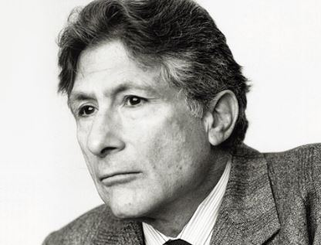
Globalisation?
Edward Said
(1935 - 2003)
“Just as none of us is outside or beyond geography, none of us is completely free from the struggle over geography. That struggle is complex and interesting because it is not only about soldiers and cannons but also about ideas, about forms, about images and imaginings.”
Culture and Imperialism
www.spinozalens.nl/en/laureates/1/Edward-Said

Slide 25
Any New Thoughts?
Discourse is the grammar of we think and express.
Most of us speak grammatically correct without always knowing the rules or consciously thinking of grammar structures while using it – and we use discourses in a similar way.

